Slide 2




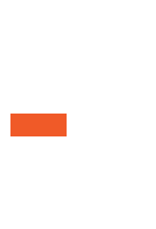



Slide 4

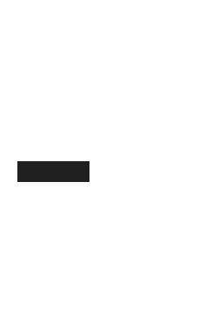



Slide 5
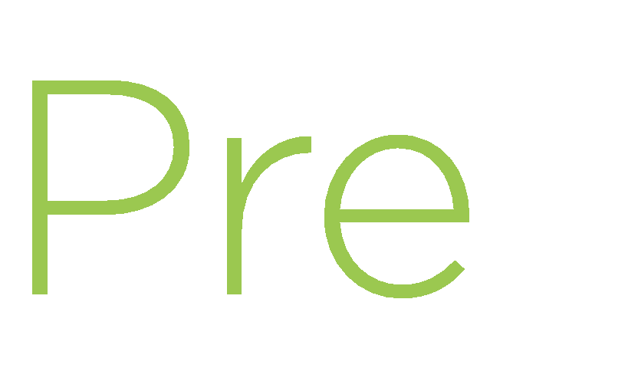
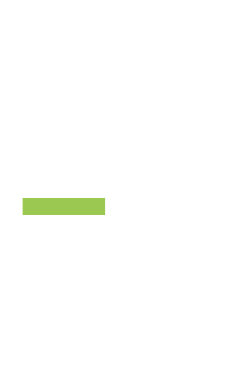



Slide 6



Slide 8

${ functionName(par1, par2, ..., parN)}
${ functionWithoutParams}

Slide 10
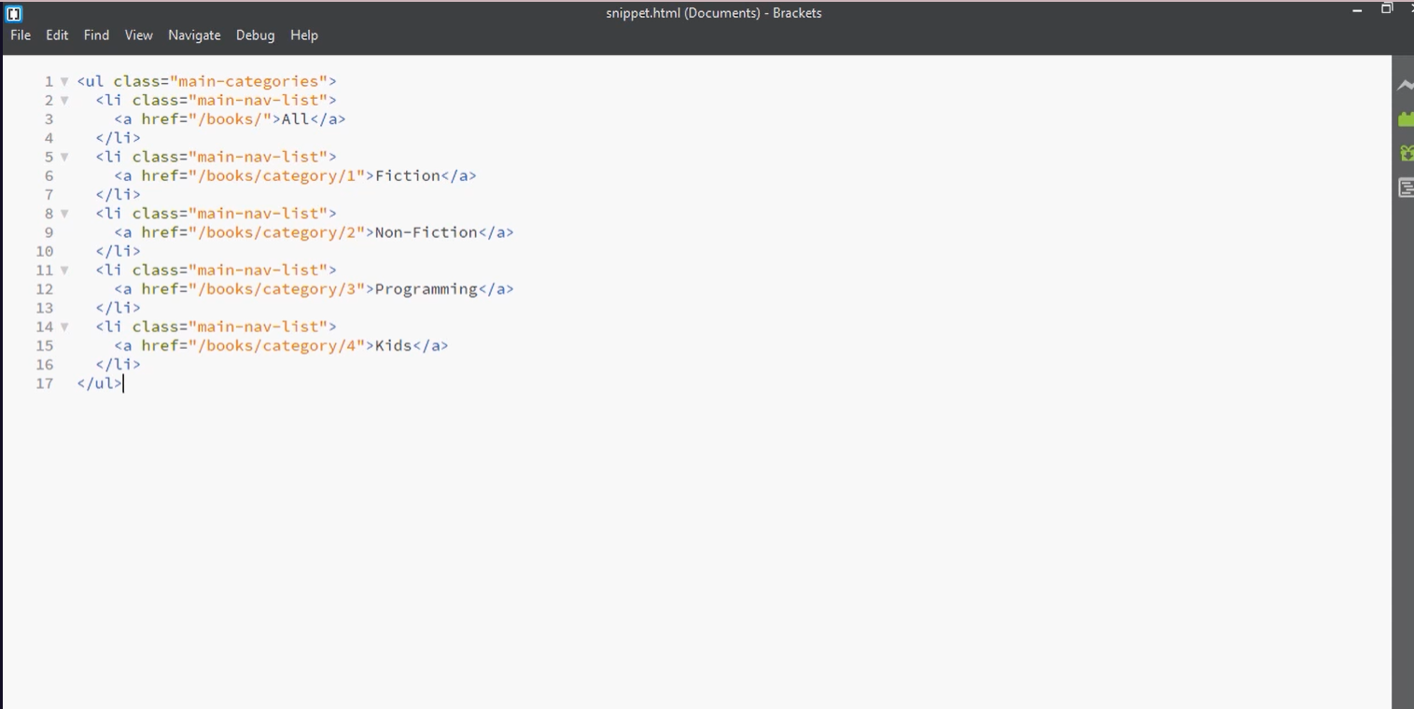

Slide 11


Slide 12


Slide 13





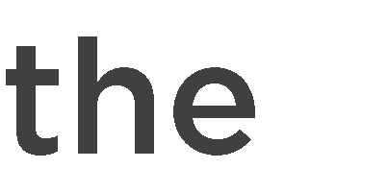




Slide 14









-
-
- ${ functionName(par1,..., parN)}
-
-

